Slide 1
Concurrent Executions
Multiple transactions are allowed to run concurrently in the system.
Advantages are:
  increased processor and disk utilization, leading to better transaction throughput
    E.g. one transaction can be using the CPU while another is reading from or writing to the disk
  reduced average response time for transactions: short transactions need not wait behind long ones.
Concurrency control schemes – mechanisms to achieve isolation that is, to control the interaction among the concurrent transactions in order to prevent them from destroying the consistency of the database

Slide 2
Why Concurrency Control is needed?
The Lost Update Problem
  This occurs when two transactions that access the same database items have their operations interleaved in a way that makes the value of some database item incorrect.
The Temporary Update (or Dirty Read) Problem
  This occurs when one transaction updates a database item and then the transaction fails for some reason
  The updated item is accessed by another transaction before it is changed back to its original value.
The Incorrect Summary Problem
  If one transaction is calculating an aggregate summary function on a number of records while other transactions are updating some of these records, the aggregate function may calculate some values before they are updated and others after they are updated.

Slide 3
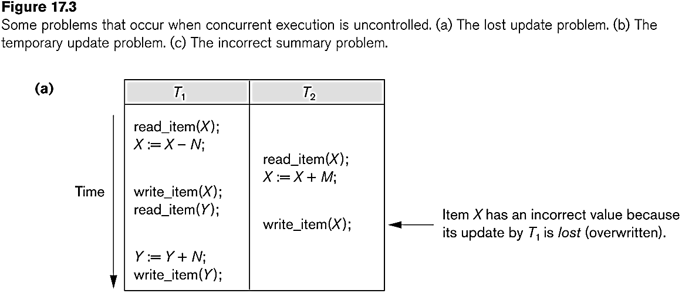
Concurrent execution is uncontrolled: (a) The lost update problem.

Slide 4
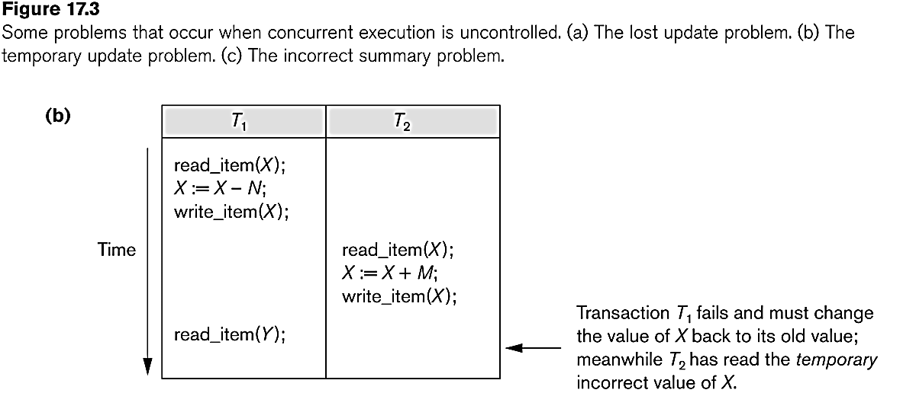
Concurrent execution is uncontrolled: (b) The temporary update problem.

Slide 5
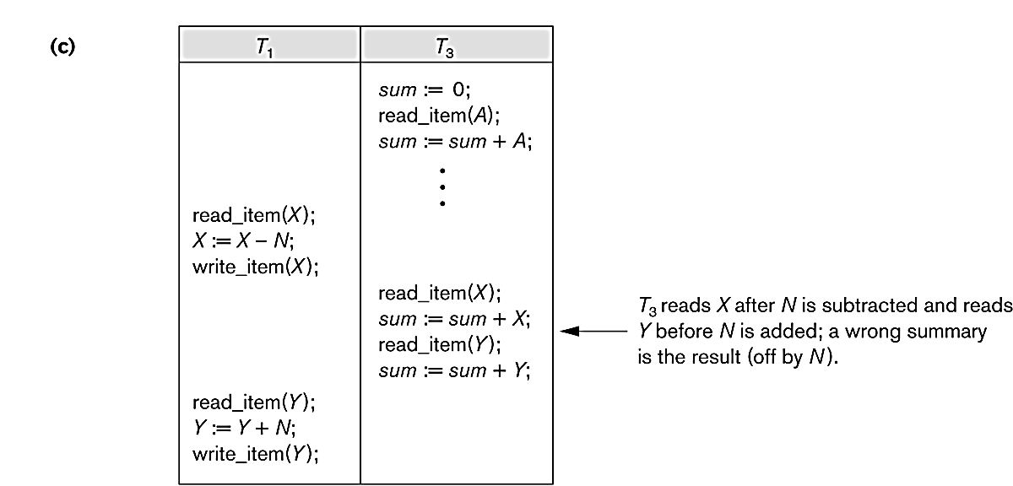
Concurrent execution is uncontrolled: (c) The incorrect summary problem.

Slide 6
Schedules
Schedule – a sequences of instructions that specify the chronological order in which instructions of concurrent transactions are executed
  a schedule for a set of transactions must consist of all instructions of those transactions
  must preserve the order in which the instructions appear in each individual transaction.
A transaction that successfully completes its execution will have a commit instructions as the last statement
  by default transaction assumed to execute commit instruction as its last step
A transaction that fails to successfully complete its execution will have an abort instruction as the last statement

Slide 7
Scheduling of Transactions
Complete Schedule: A schedule that contains either an abort or a commit for each transaction whose actions are listed in it is called a complete schedule.
Serial Schedule: Each serial schedule consists of a sequence of instructions from various transactions, where the instructions belonging to one single transaction appear together in that schedule. If the actions of different transactions are not interleaved, we call that schedule a serial schedule.

Slide 8
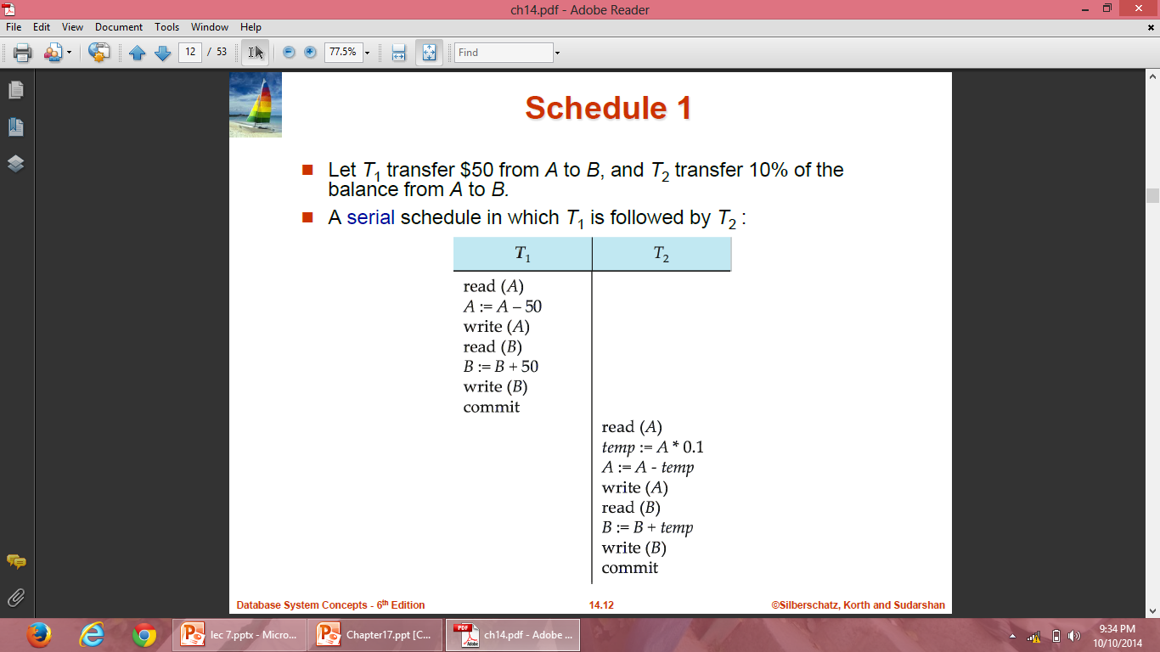
Schedule 1

Slide 9
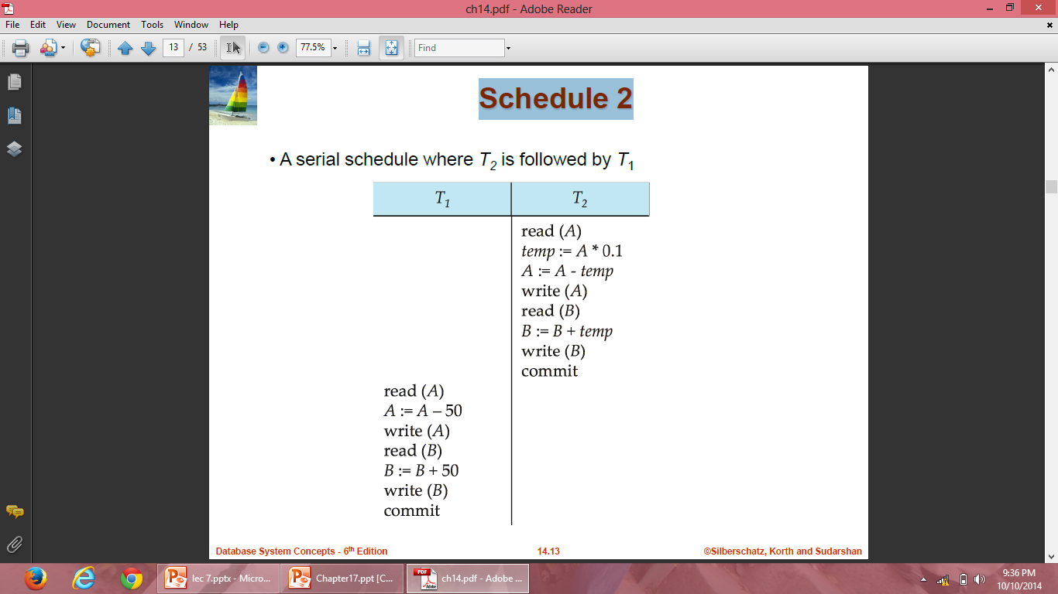
Schedule 2

Slide 10
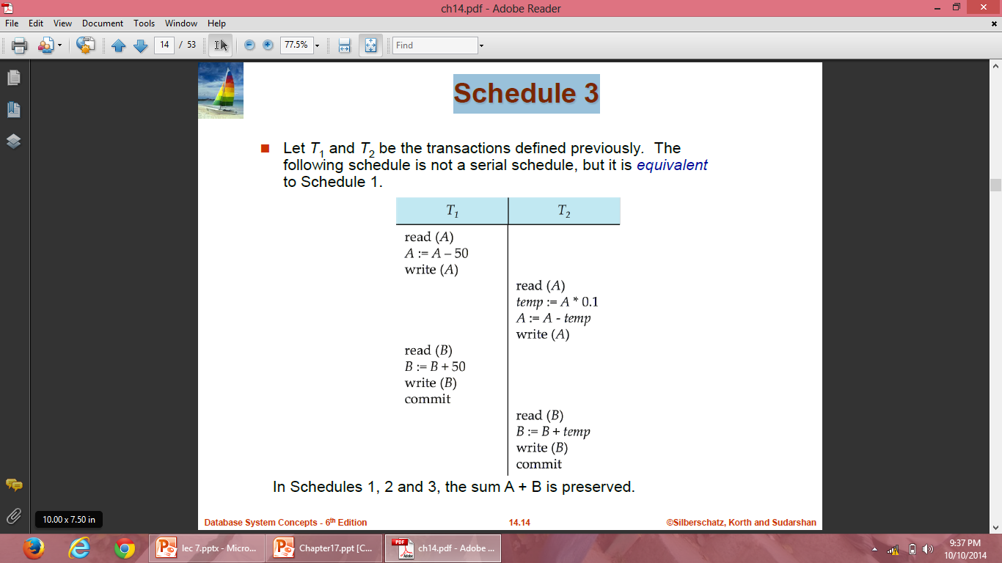
Schedule 3

Slide 11
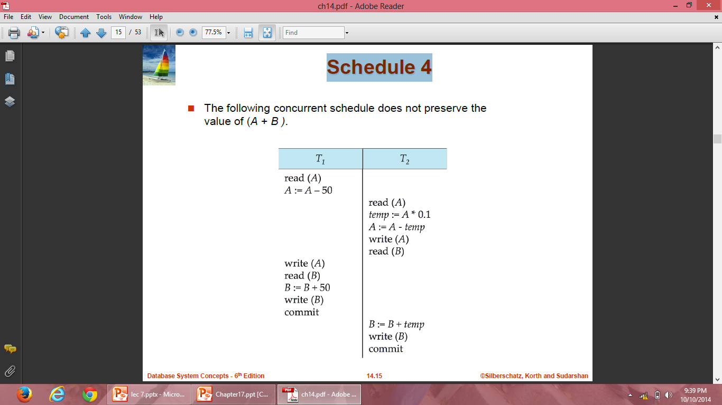
Schedule 4

Slide 12
Scheduling of Transactions
Serializiable Schedule: A non-serial schedule that is equivalent to some serial execution of transactions is called a serializiable schedule.
For example schedule-3 is serializable schedule, which is equivalent to schedule-1 and schedule-2.
The objective of serializability is to find non-serial schedules that allow transactions to execute concurrently without interfering with one another, and thereby produce a database state that could be produced by a serial execution.

Slide 13
Serializability
Basic Assumption – Each transaction preserves database consistency.
Thus serial execution of a set of transactions preserves database consistency.
A (possibly concurrent) schedule is serializable if it is equivalent to a serial schedule. Different forms of schedule equivalence give rise to the notions of:
1. conflict serializability
2. view serializability

Slide 14
Conflict Serializability
If a schedule S can be transformed into a schedule S’ by a series of swaps of non-conflicting instructions, we say that S and S’ are conflict equivalent.
We say that a schedule S is conflict serializable if it is conflict equivalent to a serial schedule.

Slide 15
Conflict Serializability
We need to check the conflicts between two consecutive operations of two different transactions in a schedule. Operations upon data can be read or write. There are two possibilities:
  If two consecutive operations are on different data items, then they do not conflict i.e, their order of execution does not matter and we can swap them without affecting their result.
  If two consecutive operations are on same data items, then they can conflict i.e their order of execution matters and we cannot swap them.

Slide 16
Conflict Serializability
Consider a schedule S in which there are two consecutive operations Oi and Oj of two transactions Ti and Tj and both operations refer to the same data item A. Then, there are following four cases:
  Oi= read(A) and Oj= read(A). Then, their order does not matter because same value of A is read by Ti and Tj.
  Oi= read(A) and Oj= write(A). Then, their order matters. If Oi comes before Oj then, Oj does not read the value of A written by Oi. If Oj comes before Oi then, Oi reads the value of A that is written by Oj.
  Oi= write(A) and Oj= read(A). Then, their order matters. If Oi comes before Oj then, Oj reads the value of A written by Oi. If Oj comes before Oi then, Oj does not read the value of A that is written by Oi.
  Oi= write(A) and Oj= write(A). Then, their order matters. If Oi comes after Oj then, the value of A written by Oi is stored in database. If Oj comes after Oi then, the value of A written by Oj is stored in database.

Slide 17
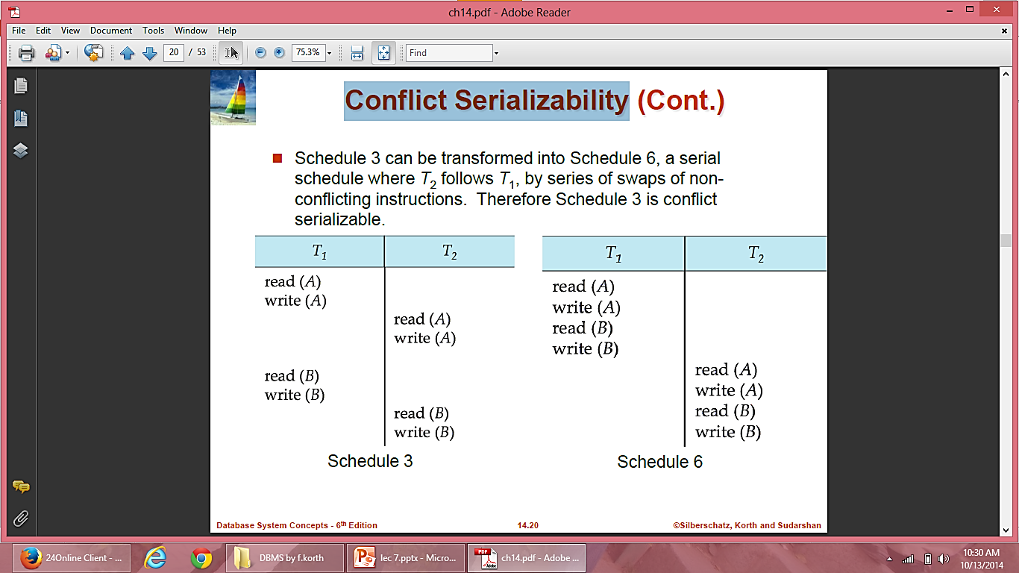
Conflict Serializability

Slide 18
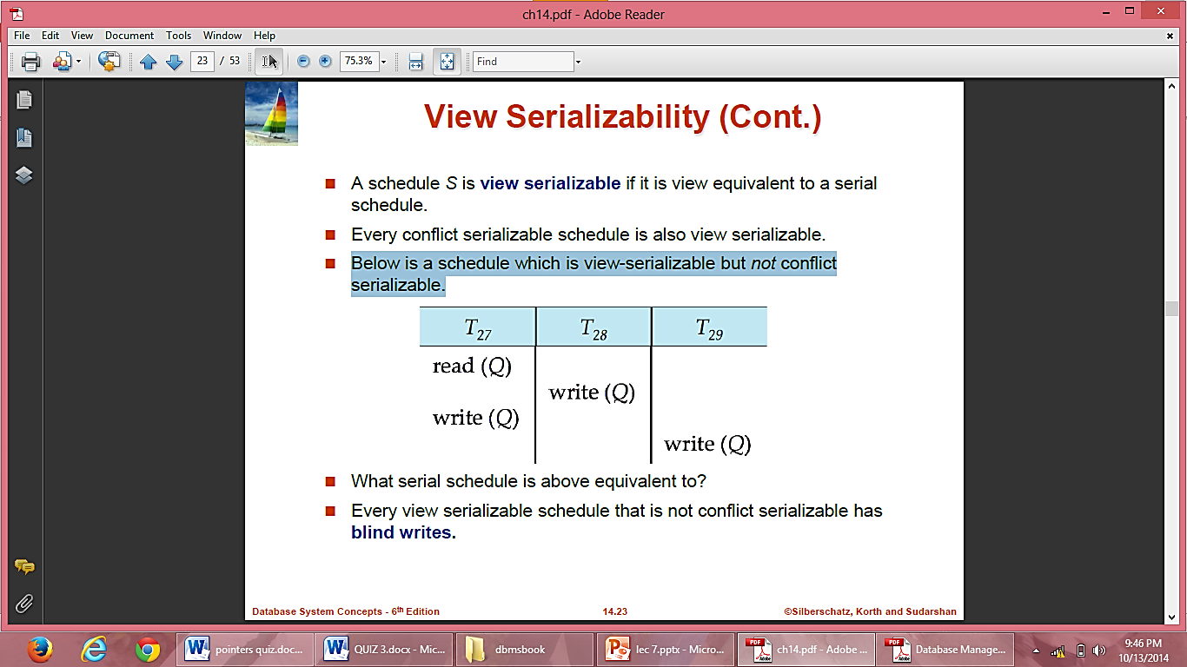
View Serializability
A schedule is said to be view-serializable if it is view-equivalent to some serial schedule.
Any schedule that is conflict-serializable is also view-serializable, but not vice versa.
Below is a schedule which is view-serializable but not conflict serializable.
Every view serializable schedule that is not conflict serializable has blind writes.

Slide 19
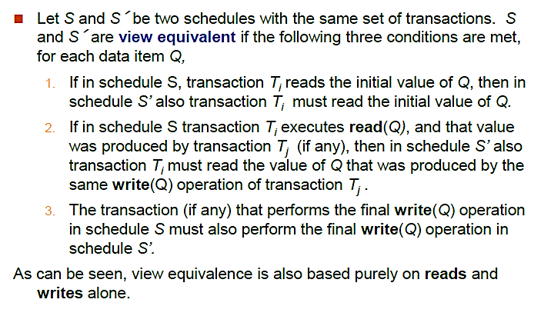
View Serializability

Slide 20
Initial read
Updated read
Final write operation

Slide 21
Examples
Schedule 1:
T1 | T2 | T3
W(A)
 | W(A)
 |  | R(A)
Schedule 2:
T1 | T2 | T3
W(A)
 |  | R(A)
 | W(A)
Check whether these Schedules are view equivalent?

Slide 22
Contd…
Schedule 1 and schedule 2 are not view equivalent

Slide 23
Examples
Schedule 3:
T1 | T2
R(A)
 | W(A)
W(A)
Schedule 4:
T1 | T2
R(A)
W(A)
 | W(A)
Check whether these Schedules are view equivalent?

Slide 24
Contd…
Schedule 3 and schedule 4 are not view equivalent

Slide 25
Schedule 5: View equivalent
T1 | T2
R(X)
W(X)
 | R(X)
 | W(X)
R(Y)
W(Y)
 | R(Y)
 | W(Y)
T1 | T2
R(X)
W(X)
R(Y)
W(Y)
 | R(X)
 | W(X)
 | R(Y)
 | W(Y)

Slide 26
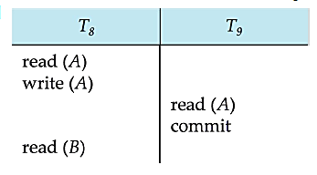
Recoverable Schedules
Need to address the effect of transaction failures on concurrently running transactions.
Recoverable schedule — if a transaction Tj reads a data item previously written by a transaction Ti , then the commit operation of Ti appears before the commit operation of Tj.
The following schedule is not recoverable if T9 commits immediately after the read
If T8 should abort, T9 would have read an inconsistent database state. Hence, database must ensure that schedules are recoverable.

Slide 27
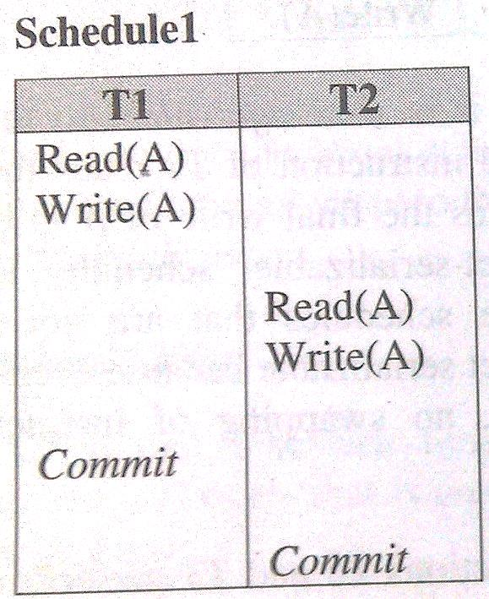
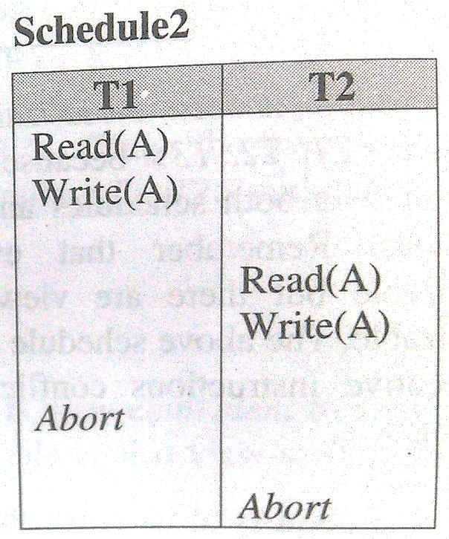
Recoverable Schedules
A schedule is said to be recoverable, if for each pair of transaction Ti and Tj such that Tj reads a data item previously written by Ti, the commit operation of Ti appears before the commit operation of Tj.
Both the above schedules are recoverable .

Slide 28
Recoverable Schedules
Schedule1 is recoverable because T2 reads the value of A updated by T1 and also T1 commits before T2 which makes the value read by T2 correct. Then T2 can commit itself.
In schedule2, if T1 is aborted, T2 has to abort because the value A it read is incorrect.
In both cases, the database is in consistent state.

Slide 29
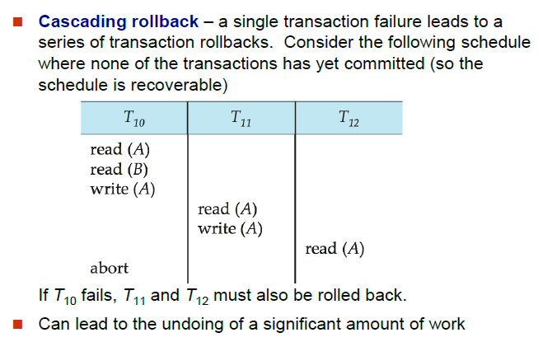
Cascading Rollbacks

Slide 30
If in a schedule, failure of one transaction causes several other dependent transactions to rollback or abort, then schedule is called as cascading schedule or cascading rollback or cascading abort.
It leads to the wastage of CPU time.
Cascading rollbacks occur because of Dirty read problems.

Slide 31
Cascadeless Schedules
Cascadeless schedules—cascading rollbacks cannot occur; for each pair of transactions Ti and Tj such that Tj reads a data item previously written by Ti, the commit operation of Ti appears before the read operation of Tj.
Every cascadeless schedule is also recoverable

